Slide 1
Parallel computing & Computer clusters
Presentation by Optimizers

Slide 2
Parallel computing
In the simplest sense, parallel computing is the simultaneous use of multiple compute resources to solve a computational problem:
A problem is broken into discrete parts that can be solved concurrently
Each part is further broken down to a series of instructions
Instructions from each part execute simultaneously on different processors
An overall control/coordination mechanism is employed

Slide 3
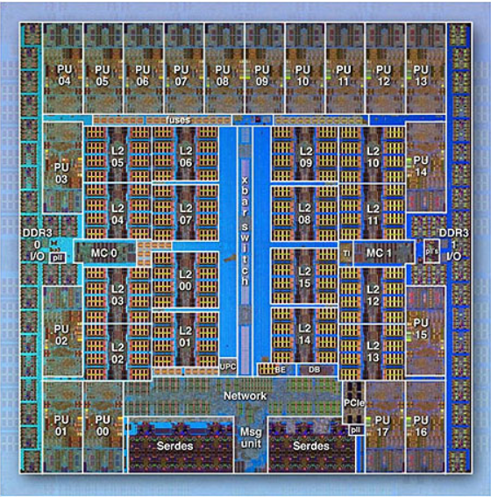
Parallel computers
Networks connect multiple stand-alone computers (nodes) to make larger parallel computer clusters.
For example, below shows a typical LLNL parallel computer cluster:
Each compute node is a multi-processor parallel computer in itself
Multiple compute nodes are networked together with an Infiniband network
Special purpose nodes, also multi-processor, are used for other purposes

Slide 4
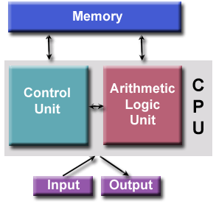
Von Neumann architecture
It is also known as stored program computer.
both program instructions and data are kept in electronic memory. Differs from earlier computers which were programmed through "hard wiring".
Comprised of four main components:
Memory
Control Unit
Arithmetic Logic Unit
Input/Output

Slide 5
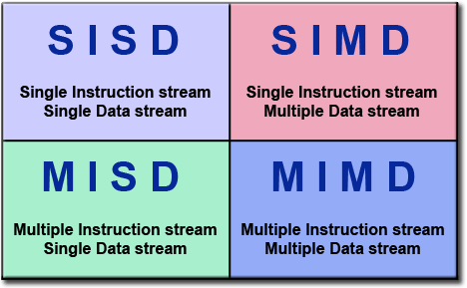
Flynn’s classical taxonomy
Flynn's taxonomy distinguishes multi-processor computer architectures according to how they can be classified along the two independent dimensions of Instruction Stream and Data Stream. Each of these dimensions can have only one of two possible states: Single or Multiple.
The matrix below defines the 4 possible classifications according to Flynn:

Slide 6
Single Instruction, Single Data(SISD):
Single Instruction: Only one instruction stream is being acted on by the CPU during any one clock cycle
Single Data: Only one data stream is being used as input during any one clock cycle Deterministic execution.
Ex: minicomputers, workstations and single processor/core PCs.
Single Instruction, Multiple data(SIMD):
Single Instruction: All processing units execute the same instruction at any given clock cycle
Multiple Data: Each processing unit can operate on a different data element
Ex: IBM 9000, Cray X-MP, Y-MP & C90

Slide 7
Multiple Instruction, Single data(MISD):
Multiple Instruction: Each processing unit operates on the data independently via separate instruction streams.
Single Data: A single data stream is fed into multiple processing units.
Ex: multiple frequency filters operating on a single signal stream
Multiple Instruction, Multiple Data(MIMD):
Multiple Instruction: Every processor may be executing a different instruction stream
Multiple Data: Every processor may be working with a different data stream
Ex: most current supercomputers, networked parallel computer clusters and "grids", multi-processor SMP computers, multi-core PCs.

Slide 8
Overview of computer cluster
A computer cluster is a group of tightly coupled computers that work together closely so that it can be viewed as a single computer.
Clusters are commonly connected through fast local area networks.
Clusters have evolved to support applications ranging from ecommerce, to high performance database applications.
Clusters are usually deployed to improve speed and/or reliability over that provided by a single computer, while typically being much more cost effective than single computer the of comparable speed or reliability.
In cluster computing each node within a cluster is an independent system, with its own operating system, private memory, and, in some cases, its own file system. Because the processors on one node cannot directly access the memory on the other nodes, programs or software run on clusters usually employ a procedure called "message passing" to get data and execution code from one node to another.

Slide 9
history
Customers invented clusters, as soon as they could not fit all their work on one computer, or needed a backup.
The first commodity clustering product was ARCnet, developed by Datapoint in 1977.
The next product was VAXcluster, released by DEC in 1980’s..
Microsoft, Sun Microsystems, and other leading hardware and software companies offer clustering packages.

Slide 10
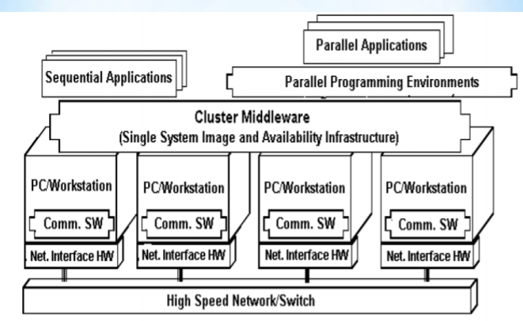
Architecture of cluster

Slide 11
A cluster is a type of parallel /distributed processing system ,which consists of a collection of interconnected stand-alone computers cooperatively working together a single , integrated computing resource.
A node:
a single or multiprocessor system with memory, I/O facilities, &OS
generally two or more computers (nodes) connected together in a single cabinet, or physically separated & connected via a LAN
appear as a single system to users and applications
provide a cost-effective way to gain features and benefits

Slide 12

Types of clusters
High Performance (HP) Clusters
Load Balancing Cluster
High Availability(HA) Clusters

Slide 13
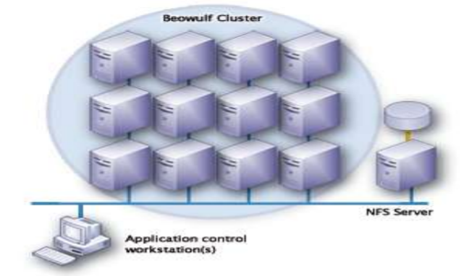
High performance clusters
Start from 1994.
Donald Becker of NASA assembled this cluster.
Also called Beowulf cluster.
Applications like data mining, simulations, parallel processing, weather modeling, etc.

Slide 14
Load balancing clusters
This types of cluster distributes incoming requests for resources or content among multiple nodes running the same program or having the same content.
Both the high availability and load balancing clusters technologies can be combined to increase the reliability, availability, scalability of application and data resources that are widely deployed for web mail news or ftp services.
Every node in the clusters is able to handle request for the same content or application.
This type of distribution is typically seen in the web hosting environment.

Slide 15
High availability cluster
Avoid single point of failure.
This requires at least two nodes - a primary and a backup.
Always with redundancy.
Almost all load balancing cluster are with HA capability.

Slide 16
Commodity components of cluster
The components critical to the development of low cost clusters are:
Processors
Memory
Sockets
Networking Components
Motherboards, busses, and other sub-systems

Slide 17
Benefits of computer cluster
1. Reduced Cost: The price of off-the-shelf consumer desktops has plummeted in recent years, and this drop in price has corresponded with a vast increase in their processing power and performance. The average desktop PC today is many times more powerful than the first mainframe computers.
2. Processing Power : The parallel processing power of a high-performance cluster can, in many cases, prove more cost effective than a mainframe with similar power

Slide 18
3. Improved Network Technology: Driving the development of computer clusters has been a vast improvement in the technology related to networking, along with a reduction in the price of such technology. Computer clusters are typically connected via a single virtual local area network (VLAN), and the network treats each computer as a separate node. Information can be passed throughout these networks with very little lag.
4. Scalability: Perhaps the greatest advantage of computer clusters is scalability they offer. While mainframe computers have a fixed processing capacity, computer clusters can be easily expanded as requirements change by adding additional nodes to the network.
5. Availability: When a mainframe computer fails, the entire system fails. However, if a node in a computer cluster fails, its operations can be carried out by other nodes.

Slide 19
challenges
The cluster computing concept also poses three pressing research challenges:
A cluster should be a single computing resource and provide a single system image. This is in contrast to a distributed system where the nodes serve only as individual resources.
The supporting operating system and communication Mechanism must be efficient enough to remove the performance Bottlenecks.
It must provide scalability by letting the system scale up or down. The scaled-up system should provide more functionality or better performance. The system’s total computing power should increase proportionally to the increase in resources. The main motivation for a scalable system is to provide a flexible, cost effective Information-processing tool.

Slide 20
applications
Internet Applications
Web serving / searching (Google Search Engine)
ASPs (application service providers)
eMail, eChat, ePhone, eBook, eCommerce ,eBank
Business Applications
E-commerce Applications (Amazon.com, eBay.com)
Database Applications (Oracle on cluster)

Slide 21
conclusion
Clusters are promising
Solve parallel processing paradox.
New trends in hardware and software technologies are likely to make clusters.
Clusters based supercomputers (Linux based clusters) can been everywhere !!
Clusters offer incremental growth and match

Slide 22
pointers
Difference between super computers and HPC.
A super computer is a computer with a high level of performance that has the architecture resources and components to achieve massive computing power.
HPC is a concept which the use of super computers and parallel processing techniques for solving complex computational problems.
Storage handle in HPC.
HPC workloads are dramatically different than enterprise computer workloads.
HPC are usually batch jobs with large datasets on large distribution computer clusters.
Storage support compute by providing the data needed for application and user.
Storage solutions :
Meet IO requirements
Manage data
Streamline data workflows with time proven automated data movement.

Slide 23
Green Computing .
It is the study and practice of environmentally sustainable computing or IT.
The goals of green computing are similar to green chemistry reduce the use of hazardous materials, maximize energy efficiency during the products life time, the recyclability or bio degradability of different products and factory waste.
Why is HPC reliable?
HPC is reliable because the entire cluster does not need to be taken down. A single node can be taken down for maintenance, while the rest of the clusters takes on the load of the individual node.

Slide 24
Thank you! Any questions. . .?

